Slide 1
Automatic Generation of Research Highlights from Scientific Abstracts
Tohida Rehman, Jadavpur University, Kolkata, India.
Debarshi Kumar Sanyal, Indian Association for the Cultivation of Science, Kolkata, India.
Samiran Chattopadhyay, TCG Crest, Jadavpur University, Kolkata, India.
Plaban Kumar Bhowmick, IIT Kharagpur, India.
Partha Pratim Das, IIT Kharagpur, India.
Notes:
Good afternoon, I am Tohida Rehman from Jadavpur University,Kolkata,India.
I am here to present our paper:
Automatic Generation of Research Highlights from Scientific Abstracts

Slide 2
Overview
Huge growth of scientific publications makes it very difficult for researchers to keep track of new research even in narrow sub-fields.
An abstract is a traditional way to present a high level view of the research paper.
One recent trend is to provide research highlights –a bulleted list of the main contributions.
We aim to automatically construct research highlights given the abstract of a paper.

Slide 3
Dataset Details
Used dataset (URLs) released by Collins et al.[2].
URLs of 10142 computer science publications from ScienceDirect.
Dataset is organized as (abstract, author-written research highlights).
Training : 8115 pairs.
Validation : 1014 pairs.
Testing : 1013 pairs.
Average abstract size : 186 words.
Average author-written research highlights : 52 words.

Slide 4
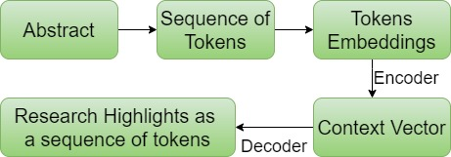
Workflow of our system
Used 3 deep learning-based models to generate research highlights.
1. Sequence-to-sequence (seq2seq) model with attention [3].
2. Pointer-generator network [8].
3. Pointer-generator network with coverage mechanism [8] [9].
Notes:
Each abstract is tokenized and the tokens are converted to 128-dimensional GloVe vectors.
Then that are sequentially fed into the encoder which is a single-layer bidirectional Long Short-Term Memory (BiLSTM).
The decoder is a single-layer unidirectional LSTM.
we used the same vocabulary of around 50K tokens, beam search in the decoder with size 4.
Maximum input size of 400 tokens and maximum output size of 100 tokens.

Slide 5
Evaluation Results
 | ROUGE |  |  |  |  |  |  |  |  | METEOR
 | ROUGE-1 |  |  | ROUGE-2 |  |  | ROUGE-L |  |  | Synonym/paraphrase/stem
 | R | P | F1 | R | P | F1 | R | P | F1 | R | P | F1 | Final Score
Model 1 | 20.90 | 20.47 | 19.90 | 02.02 | 02.02 | 1.93 | 19.49 | 19.16 | 18.58 | 17.86 | 17.69 | 17.78 | 7.39
Model 2 | 30.99 | 32.07 | 30.9 | 7.48 | 8.06 | 7.55 | 28.66 | 30.34 | 28.62 | 25.53 | 26.61 | 26.06 | 11.04
Model 3 | 31.6 | 33.32 | 31.46 | 8.52 | 9.2 | 8.57 | 29.2 | 30.9 | 29.14 | 27.64 | 29.26 | 28.43 | 12.01

Slide 6
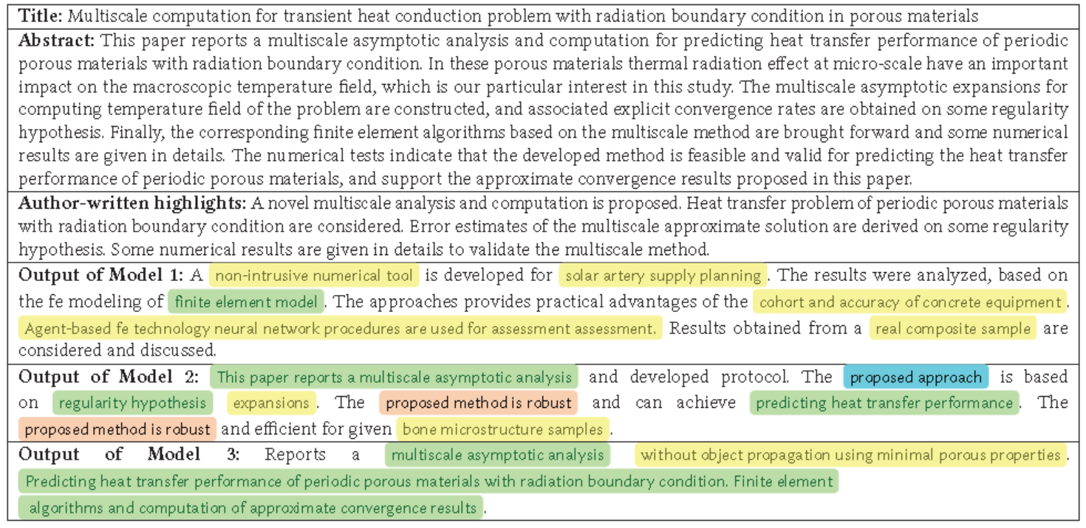
Comparison of model-generated Research Highlights
Abstract taken from
https://www.sciencedirect.com/science/article/abs/pii/S0168874X15000621
The meaning of the colors are explained in main text:
Notes:
Model 1 generated many OOV words and factual errors .
Model 2 generates more meaningful research highlights and even relevant novel words but repeating words sometimes.
Model 3 reduces repeating words and highlights are more meaningful.

Slide 7
Conclusion
The pointer-generator network with coverage mechanism achieved the best performance.
But the predicted research highlights are not yet perfect.
We are currently exploring other techniques to improve the system.

Slide 8
References
[1] Dzmitry Bahdanau, Kyunghyun Cho, and Yoshua Bengio. 2015. Neural machine translation by jointly learning to align and translate. In ICLR.
[2] Ed Collins, Isabelle Augenstein, and Sebastian Riedel. 2017. A supervised approach to extractive summarisation of scientific papers. In CoNLL.
[3] Ramesh Nallapati, Bowen Zhou, Caglar Gulcehre, Bing Xiang, et al. 2016. Abstractive text summarization using sequence-to-sequence RNNs and beyond. In CoNLL. 280–290.
[4] Jeffrey Pennington, Richard Socher, and Christopher D Manning. 2014. GloVe: Global vectors for word representation. In EMNLP. 1532–1543.
[5] TYSS Santosh, Debarshi Kumar Sanyal, Plaban Kumar Bhowmick, and Partha Pratim Das. 2018. Surrogator: A tool to enrich a digital library with open access surrogate resources. In JCDL. 379–380.
[6] Tokala Yaswanth Sri Sai Santosh, Debarshi Kumar Sanyal, Plaban Kumar Bhowmick, and Partha Pratim Das. 2020. DAKE: Document-Level Attention for Keyphrase Extraction. In ECIR.
[7] Debarshi Kumar Sanyal, Plaban Kumar Bhowmick, Partha Pratim Das, Samiran Chattopadhyay, and TYSS Santosh. 2019. Enhancing access to scholarly publications with surrogate resources. Scientometrics 121, 2 (2019), 1129–1164.
[8] Abigail See, Peter J Liu, and Christopher D Manning. 2017. Get to the point: Summarization with pointer-generator networks. In ACL.
[9] Zhaopeng Tu, Zhengdong Lu, Yang Liu, Xiaohua Liu, and Hang Li. 2016. Modeling coverage for neural machine translation. In ACL.
[10] Richard Van Noorden. 2014. Global scientific output doubles every nine years. Nature news blog (2014).

Slide 9
Contact Details
Tohida Rehman, Email: tohida.rehman@gmail.com
Debarshi Kumar Sanyal, Email: debarshisanyal@gmail.com
Samiran Chattopadhyay, Email: samirancju@gmail.com
Plaban Kumar Bhowmick, Email: plaban@cet.iitkgp.ac.in
Partha Pratim Das, Email: ppd@cse.iitkgp.ac.in

